Slide 1
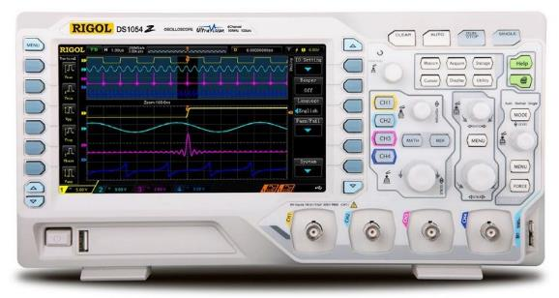

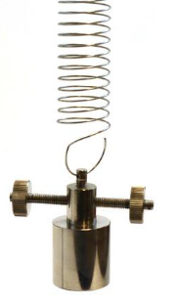
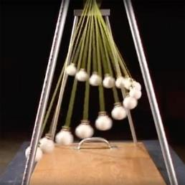
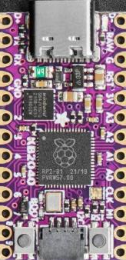
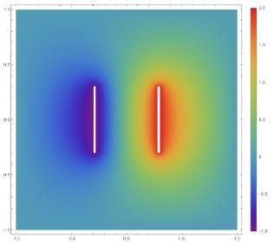
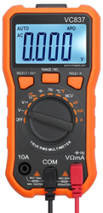

Scientific Computing
Demonstrations
Using Python on a Microcontroller with Sensors
Biot-Savart Law
Dave Biersach
dbiersach@bnl.gov

Slide 2
Lab Goals
Compare and contrast spectrophotometry (reflection) with spectrometry (emission & absorption)
Correlate wavelengths of light to perceived common colors
Identify the wavelengths associated with ultraviolet and infrared light
Develop reflectance spectra histograms of pure elements and complex compounds
Attempt to identify unknown materials via their reflectance spectra

Slide 3
Research Questions
Do things appear to be colored because of the wavelengths of visible light they absorb or reflect? Explain the photon-electron interaction between white surfaces vs. a mirror
In this lab setup, why does an empty scan contain many wavelengths having low reflectance values?
Which object has the reflection spectra with the fewest number of measured wavelengths?
Which absorbs more UV light: lighter or darker objects? Why? Which absorbs more IR light: lighter or darker objects? Why?
What is one use for material which reflects UV light but not visible light?

